Slide 1






Health Literacy
Učenje i zajednički rad u cilju poboljšanja zdravstvenih ishoda – jačanje interprofesionalnog obrazovanja / Learning and working together for improved healthcare outcomes – strengthening interprofessional education
Authors: Marina Odalović, University of Belgrade – Faculty of Pharmacy
Department of Department of Social Pharmacy and Pharmaceutical Legislation
Belgrade, June 2025.

Slide 2
Framework for Action on Interprofessional Education & Collaborative Practice – SZO, 2010
Interprofessional education (IPE) is an approach to teaching and learning that brings together students from two or more professions to learn about, from, and with each other to enable effective collaboration!
- A necessary prerequisite for successful collaborative practice and integrated healthcare!

Slide 3
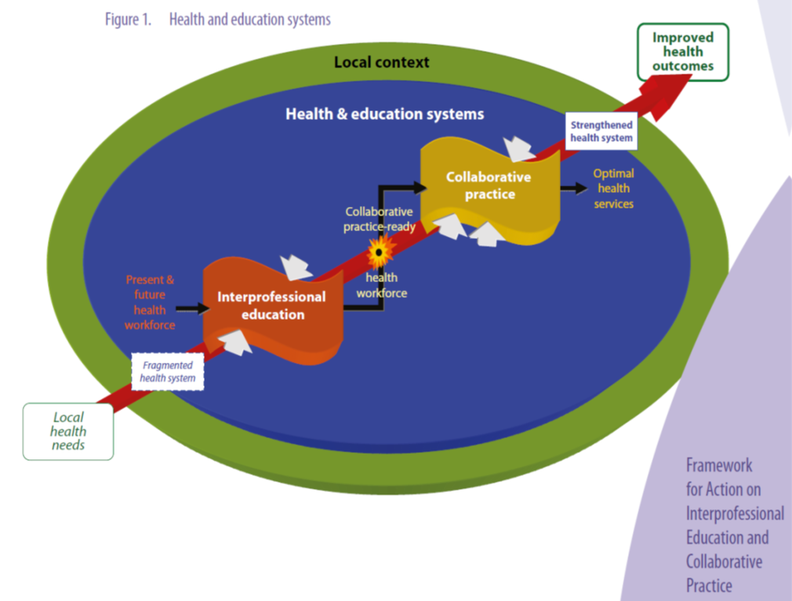
Framework for Action on Interprofessional Education & Collaborative Practice – WHO, 2010
Links IPE to Collaborative Practice, and therefore, to Health Outcomes
Because each country’s health system is different it proposes three actions to promote implementation:
Contextualise
Commit
Champion

Slide 4
PSI, 2024: Acreditation standards for the Five Year Master’s Degree Programmes in Pharmacy
Standard 1. Strategy: Provides structured experience of interprofessional learning to facilitate teamwork in enhancing patient care.
Standard 2. Leadership, Organisation and Governance: The HEI must support the development of suitable relationships between the School and other academic and service units of the HEI for instruction, research, practice-based and interprofessional learning. External relationships or collaborations with the pharmacy profession must be facilitated to foster the School’s teaching, learning and research capabilities. The School should have access to, and arrangements with HEI affiliated and other healthcare facilities in support of the practice-based and interprofessional learning needs of the Professional Degree Programme
Standard 5. Curriculum - Teaching, Learning and Assessment: interprofessional collaboration with students of other healthcare professions in all stages of the Professional Degree Programme, interprofessional teamworking and leadership skills.

Slide 5
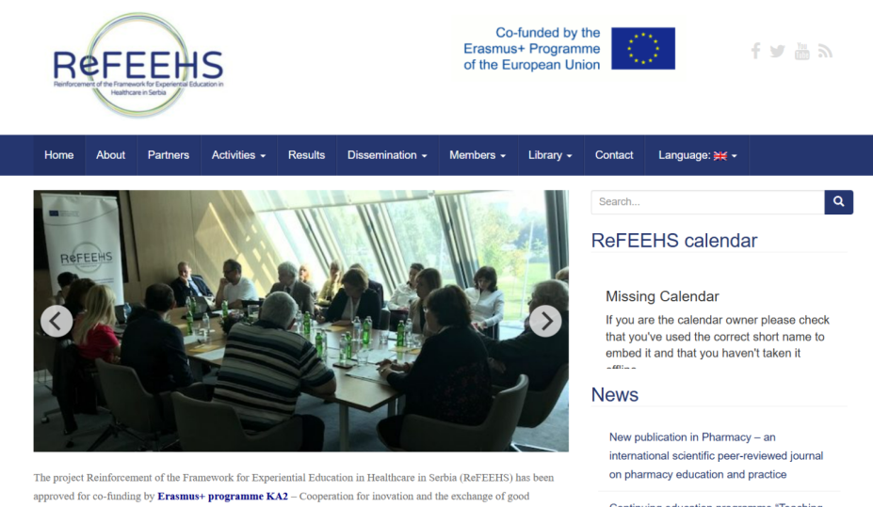
Erasmus+ ReFEEHS project (2015-2018)
Objectives:
1. Reinforcement and modernization of experiential education (clinical experience, students’ professional practice) curricula in health sciences, including medicine, dentistry, pharmacy and nursing.
2. Introduction of interprofessional teaching and learning activities, including new joint interprofessional courses for all health science students.
3. Teaching Competencies Development of academic staff and teacher practitioners, including introduction of Teaching Certificate study programme.

Slide 6

LEARNING AND WORKING TOGETHER FOR IMPROVED HEALTHCARE OUTCOMES – STRENGTHENING INTERPROFESSIONAL EDUCATION
UČENJE I ZAJEDNIČKI RAD U CILJU POBOLJŠANJA ZDRAVSTVENIH ISHODA –
JAČANJE INTERPROFESIONALNOG OBRAZOVANJA
WhoLeIPE

Slide 7




WhoLeIPE key information
Program: Erasmus+
Action Type: Cooperation partnerships in higher education (KA220-HED)
Project time span: 3 years (01/12/2024 - 30/11/2027)
Project budget (lump sum): 120.000,00 EUR
Consortium:
University of Belgrade, coordinator (UB), Belgrade, Serbia
The College of the Holy & Undivided Trinity of Queen Elizabeth Near Dublin (TCD), Dublin, Ireland
Medical University Karola Marcinkowskie, Poznan (PUMS), Poznan, Poland

Slide 8

Objectives
WhoLe IPE Project is aimed at the enhancement of health professionals competencies by creating and applying innovative learning and teaching practices in health professions education.
General Project objective is: advancement of IPE and interprofessional collaborative practice as foundation for development of comprehensive, coordinated, resilient and responsive health system based on the integrative healthcare (IHC) focused on the improved patient outcomes.

Slide 9
Implementation
Courses of activities
Work Packages
Development and implementation of innovative learning and teaching programs for: (i) HPs; (ii), health sciences students, and (iii) academic staff engaged in HPs education;
Preparation and publication of relevant supporting materials and educational resources;
Raising awareness among different stakeholders about the importance of IPE and IHC.
Project Management
Towards the Integrated Healthcare (TIH)
Strengthening Interprofessional Curricula (SIC)
Training of Trainers (ToT)
Dissemination and Exploitation (D&E)

Slide 10



Join us:
Instagram LinkedIn www.wholeipe.com

Slide 11

Many thanks for your attention!

